Slide 1
Belisarius
The Hero Behind Justinian
Qianyu Lin

Slide 2
Belisarius, byzantine general (ca.505-565)
Flavius Belisarius is a general of the Byzantine Empire who first appeared as a bodyguard of Justinian I in history.
In The Life of Belavius (1829) by Lord Mahon, who writes about Belisarius’ s early life:
  “Belisarius was born at Germania, on the confines of Thrace and Illyria. The exact age of Belisarius is not recorded; His first military enterprise took place about two years before the accession of Justinian.”

Slide 3
A life contributed to wars
The Emperor he served for, Justinian, who was one of the stars in the long history of the Roman Empire, was most famous for his wars of reconquest in Italy, North Africa, and parts of Spain long lost to barbarians. His war map was splendid, including both the East and West Roman Empire, which had been divided apart into two halves since the time of Diocletian in the third century A.D. It was “a grandiose scheme of imperial recovery envisaged by Justinian” (Procopius) Then the mission of the endless war went to Belisarius.

Slide 4
The path of the wars highlights and triumphs
Battle in Dara( 530) against Persians.
Battle in Carthage (533) against vandals.
Wars in Italy(535) fight the Goths and defend Rome.
  first invaded Sicily and then moved on to Naples. Finally reached Rome, defeated the Vandals at Ravenna.
Successfully repelled the attempted invasion of Bulgars who advanced to the walls of Constantinople.(559).

Slide 5
Battle of Dara
Concluded into three phrases : Initial formations and first Persian attack, Persian right wing attack and Persian left wing attack.
Strategies ( represent Roman tradition of military excellence) : preparation of the battlefield; observation; psychological operations.

Slide 6
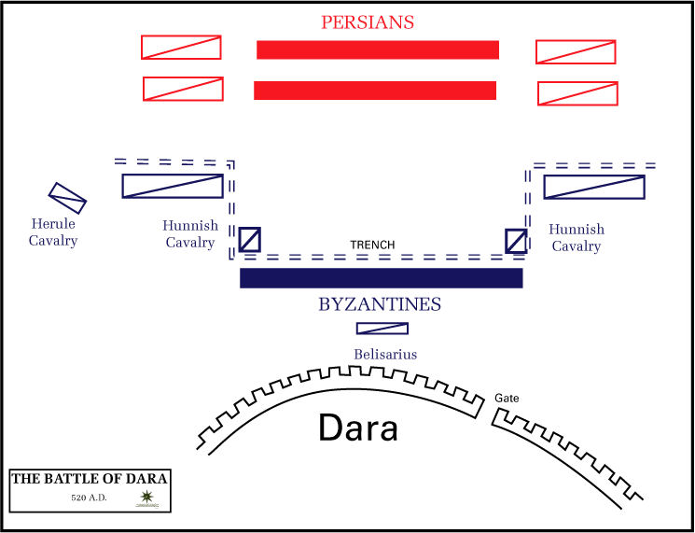

Slide 7
Historical significance:
  It “substantially weakened Persia’s westernmost army, halting Persian efforts to mount an overwhelming offense across the eastern boundary of the Byzantine Empire and leaving Persia’s western border region vulnerable to seizure. Persia was therefore forced to negotiate terms for an enduring peace, and the Byzantine Empire’s integrity was preserved.”
  The byzantine wars, John Haldon

Slide 8
Carthage 533
At Carthage on 14 September 533, Belisarius faced a Vandal army of some 160,000 men; “historians agree that the Byzantine forces were far inferior in numbers.”( Grossman) The Vandals under Gelimer divided into three wings and attacked the main Byzantine army.
Belisarius used the best moment to launch an assault on Gelimer and forced the Vandals to flee, resulting in Carthage’s surrender. He took Gelimer as his prisoner and returned to Byzantium in triumph.

Slide 9
Good reputation
A man with talents and achievements and also had an ideal appearance easily became the public hero:
“The Byzantines loved to see Belisarius going from his house to the square everyday, or returning to it – no one could get enough of the sight of him.” (Procopius)
“always accompanied by a throng of Vandals and Goths and Moors.”(Procopius)
he was well built and he was tall and handsome just like an inborn hero. Also, he was affable and easily accessible to anyone he met.
an upright man. “ He was remarkable for his sobriety - he would never touch any woman but his wedded wife.” and “no one ever saw Belisarius drunk”(Procopius).

Slide 10
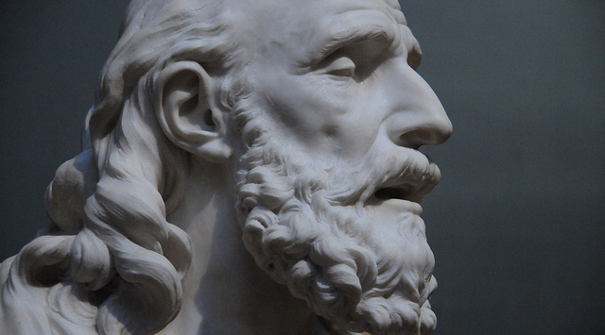

Slide 11
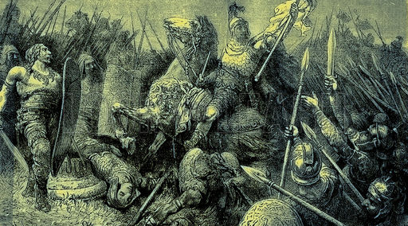

Slide 12
Belisarius and Justinian
According to Procopius, the author of History of the Wars accounted, Justinian believed in his military talent and he was always made to be the leading figure of battles.
He was not only a close friend of Justinian’s but also the one he relied on for his plan of reconquest.

Slide 13
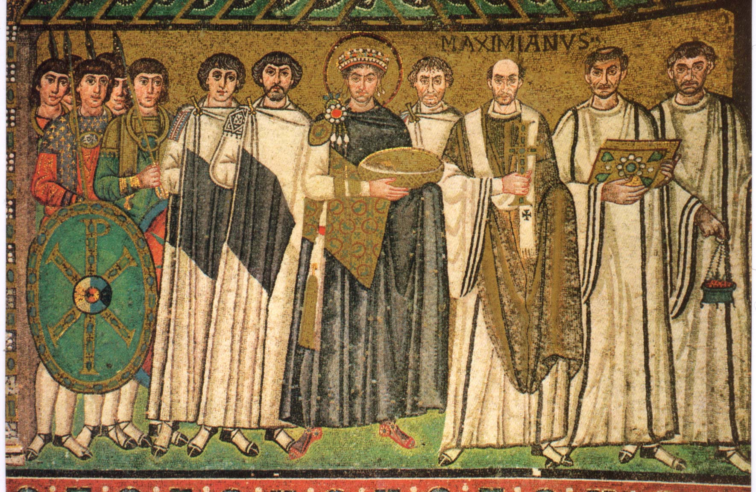

Slide 14
However, Belisarius’s loyalty and ability couldn’t fully win the trust of the Emperor who had a “suspicious nature”(Procopius) because Belisarius was too outstanding and too important to be favored but there was no doubt that every aspect of Justinian’s attitudes towards Belisarius showed how good this general was.
In Ravenna in 539, The Goths offered to let Belisarius be the emperor of the west. Belisarius used it as a tool to make them surrender but misunderstood by Justinian.
He was placed in Italy to fight in an inadequate resources in 548.
In 559, Justinian regarded Belisarius with suspicion; he was arrested on charges of conspiring to remove the emperor, and his property was confiscated. Gained back good name until 563, two years before his death.

Slide 15
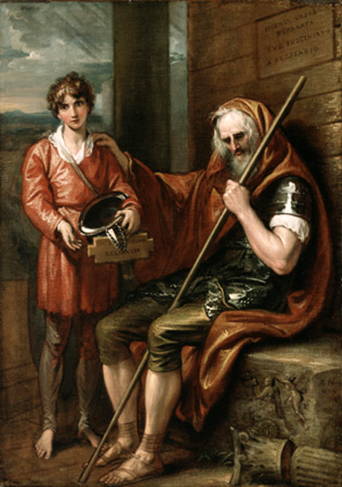

Slide 16
The conclusion of Belisarius
The eighteenth century historian Edward Gibbon “placed the eastern roman empire general Belisarius above all the great commanders of antiquity.”
Highly thought of:
  the nature of Belisarius’ service to the empire.
  his contributions to the wise of arrangement of the war.
  extraordinary personalities and bearings he had and the tenets he held throughout his whole period of life.

Slide 17
Belisarius, who was an expert in battles and a representative of virtues, stood behind Justin to help achieve the splendid reunion of the Roman Empire and also the historical position himself.

